Slide 1
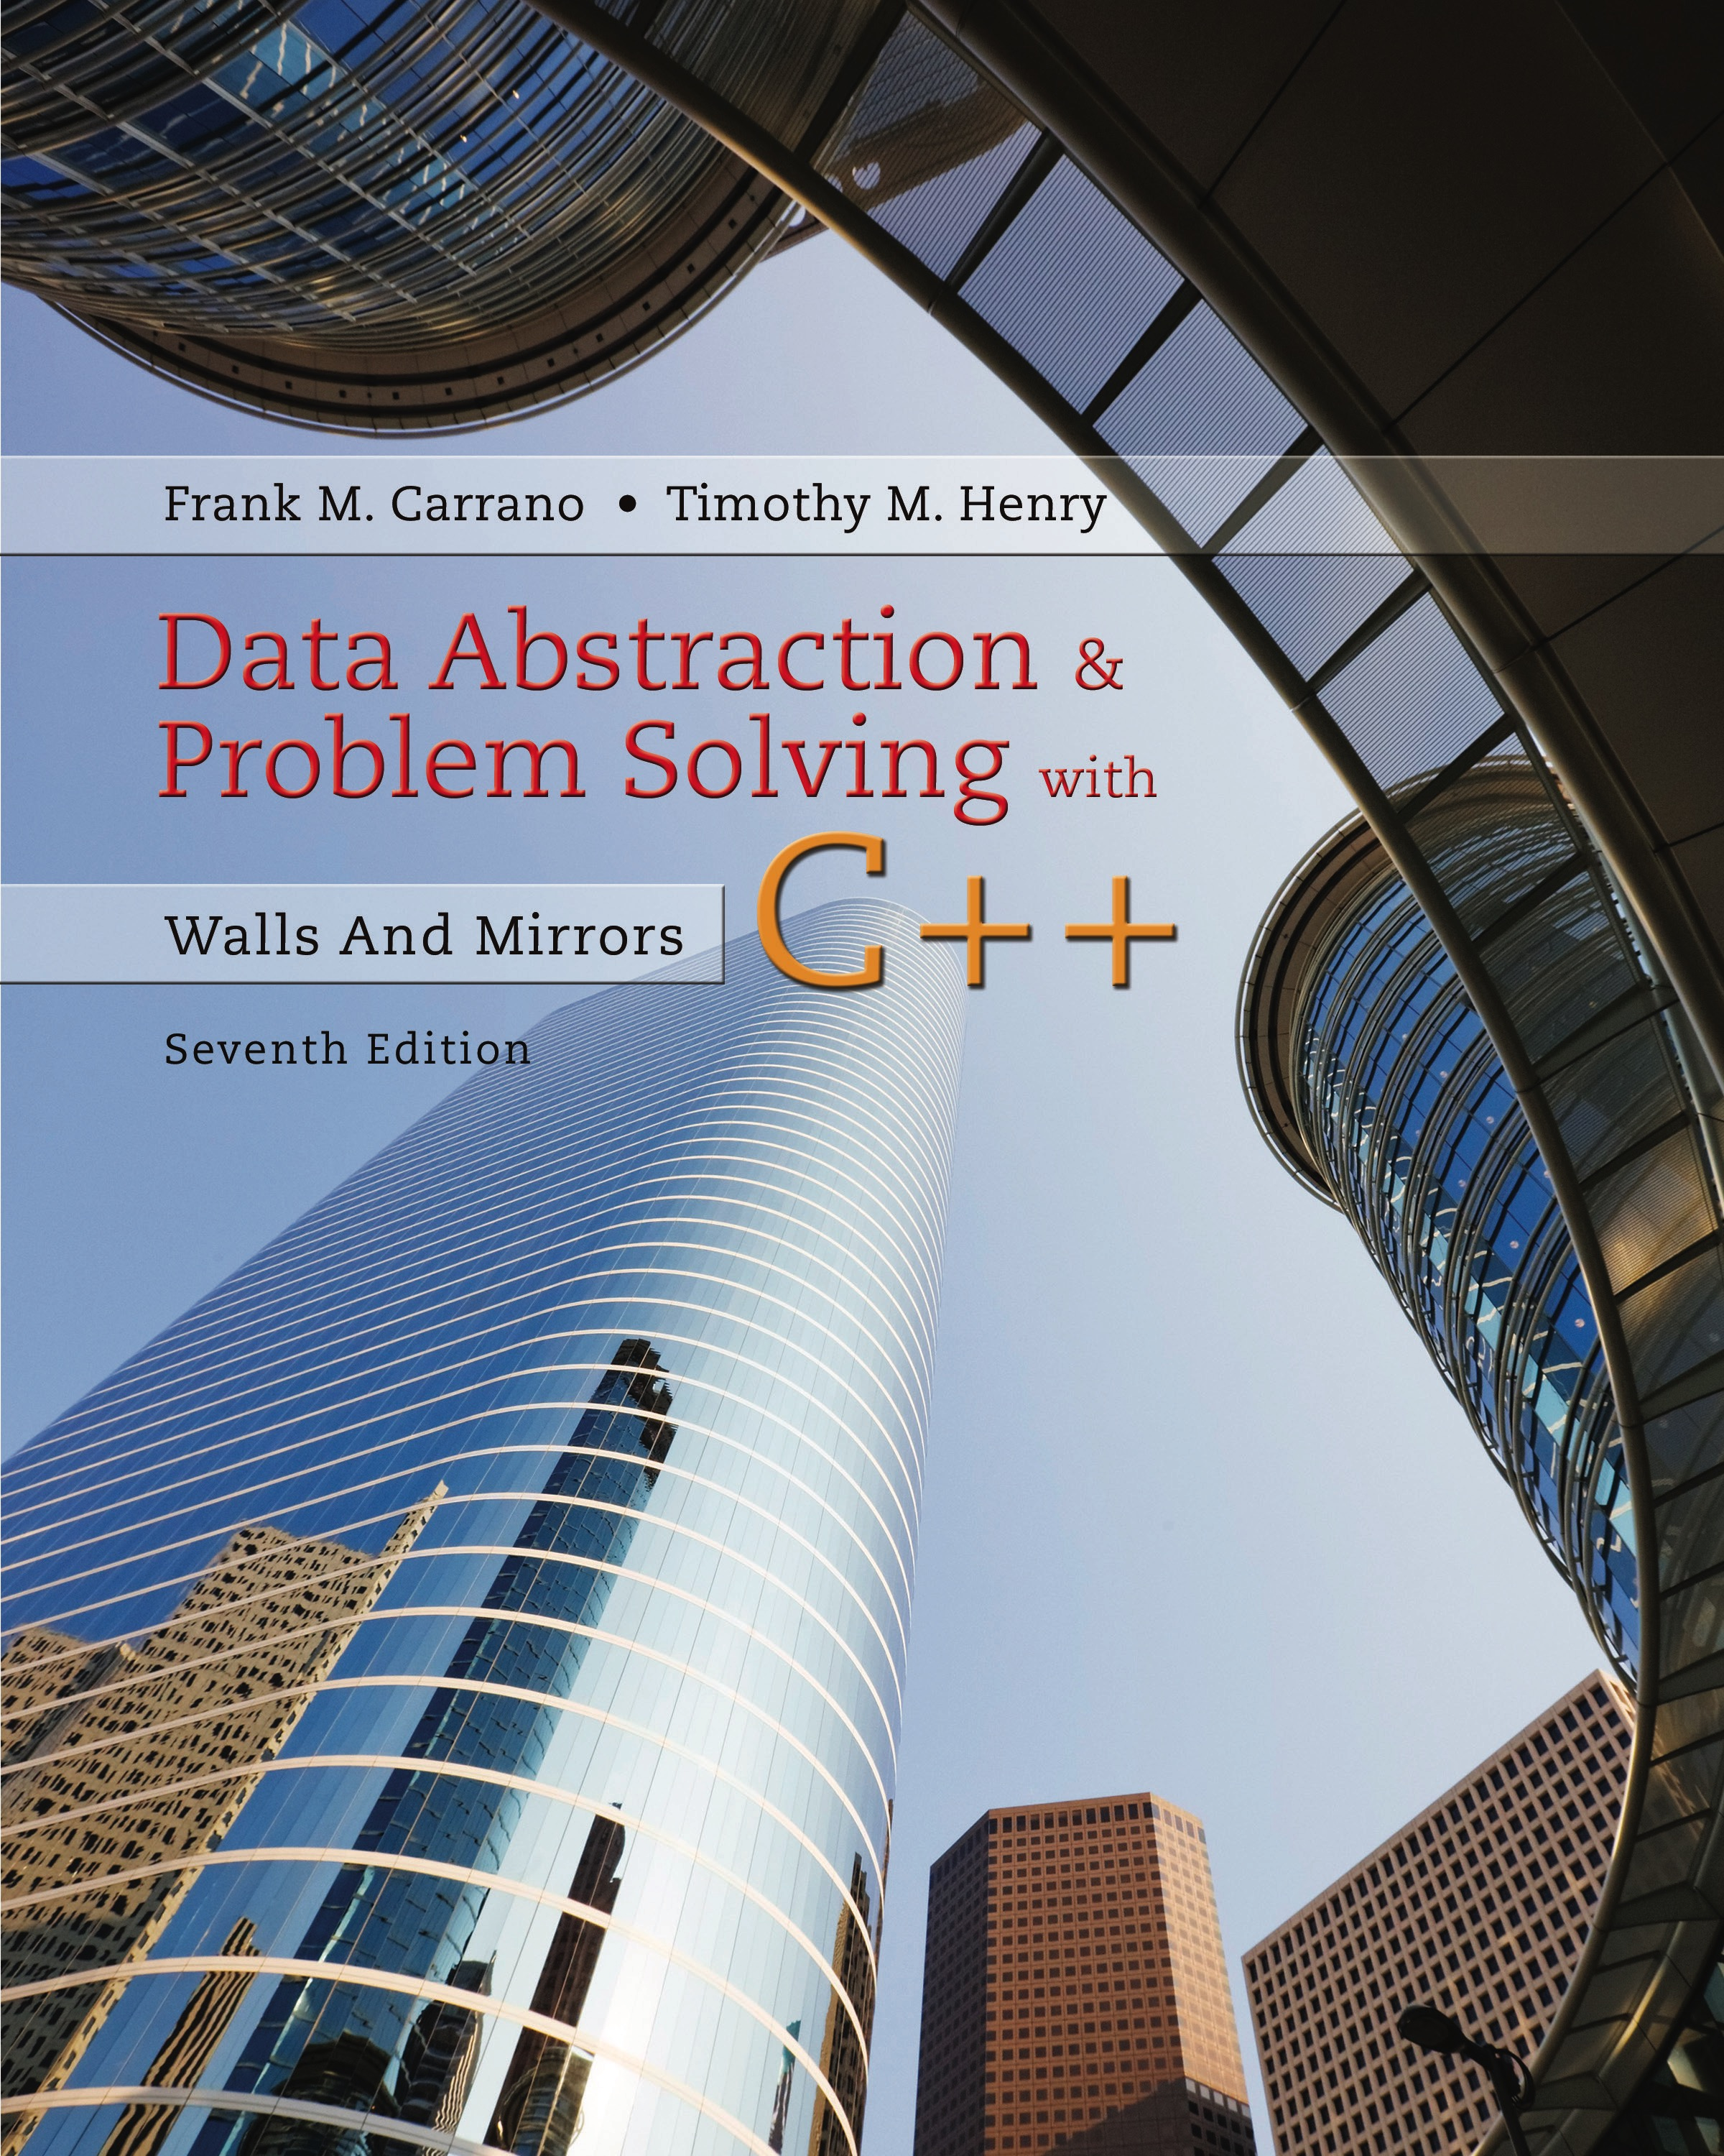
Data Abstraction & Problem Solving with C++: Walls and Mirrors
Seventh Edition
Chapter 11
Sorting Algorithms and Their Efficiency
Copyright © 2017, 2013, 2007 Pearson Education, Inc. All Rights Reserved
Notes:
If this PowerPoint presentation contains mathematical equations, you may need to check that your computer has the following installed:
1) MathType Plugin
2) Math Player (free versions available)
3) NVDA Reader (free versions available)

Slide 2
Basic Sorting Algorithms (1 of 2)
Sorting:
Organize a collection of data into either ascending or descending order
Internal sort
Collection of data fits in memory
External sort
Collection of data does not all fit in memory
Must reside on secondary storage

Slide 3
Basic Sorting Algorithms (2 of 2)
The Selection Sort
The Bubble Sort
The Insertion Sort

Slide 4
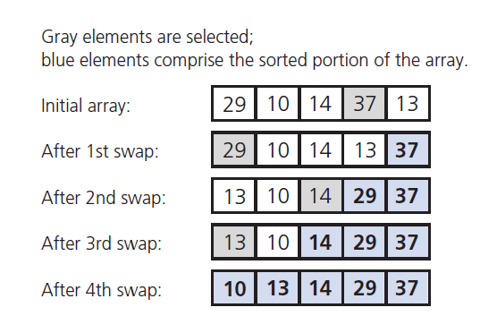
The Selection Sort (1 of 5)
Figure 11-1 A selection sort of an array of five integers

Slide 5
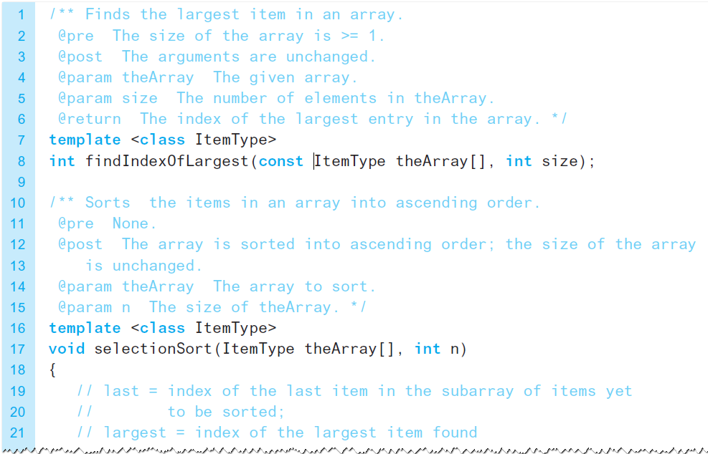
The Selection Sort (2 of 5)
Listing 11-1 An implementation of the selection sort

Slide 6
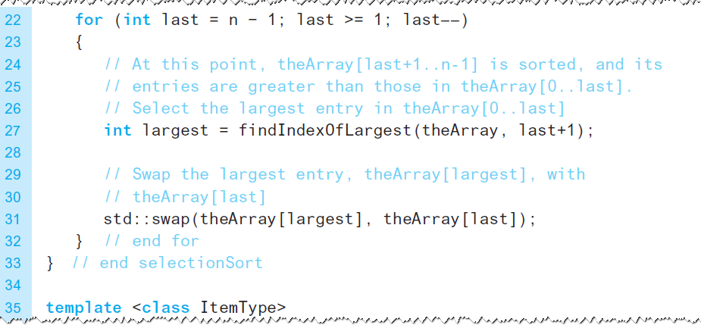
The Selection Sort (3 of 5)
Listing 11-1 [Continued]

Slide 7
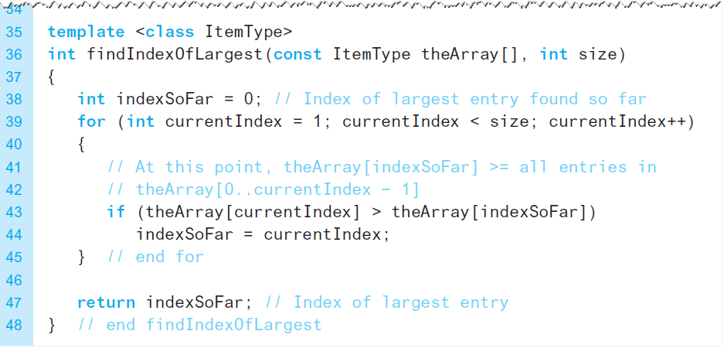
The Selection Sort (4 of 5)
Listing 11-1 [Continued]

Slide 8
The Selection Sort (5 of 5)
Analysis
Selection sort is
Appropriate only for small n,
,
grows rapidly
Could be a good choice when
Data moves are costly,
But comparisons are not

Slide 9
The Bubble Sort (1 of 5)
Compares adjacent items
Exchanges them if out of order
Requires several passes over the data
When ordering successive pairs
Largest item bubbles to end of the array

Slide 10
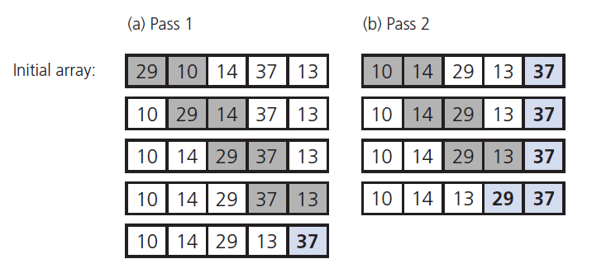
The Bubble Sort (2 of 5)
Figure 11-2 First two passes of a bubble sort of an array of five integers

Slide 11
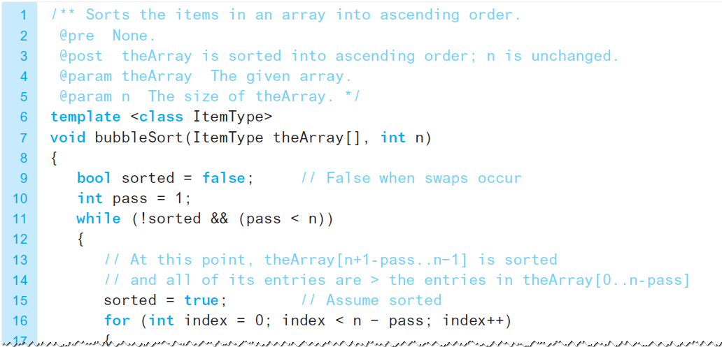
The Bubble Sort (3 of 5)
Listing 11-2 An implementation of the bubble sort

Slide 12
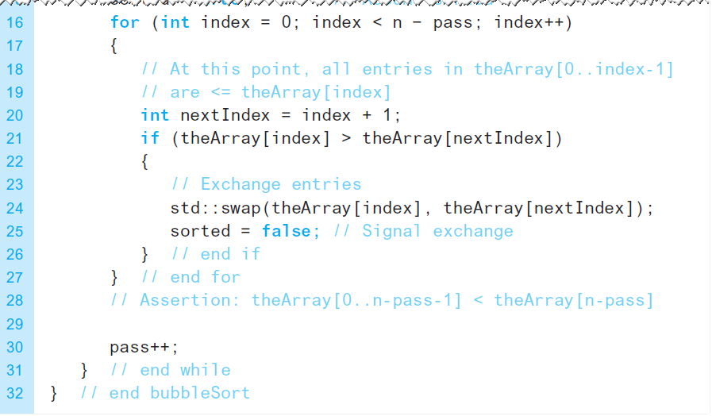
The Bubble Sort (4 of 5)
Listing 11-2 [Continued]

Slide 13
The Bubble Sort (5 of 5)
Analysis
Worst case
Best case (array already in order) is

Slide 14
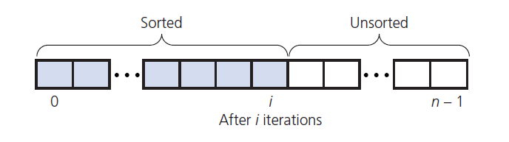
The Insertion Sort (1 of 5)
Take each item from unsorted region
Insert it into correct order in sorted region
Figure 11-3 An insertion sort partitions the array into two regions

Slide 15
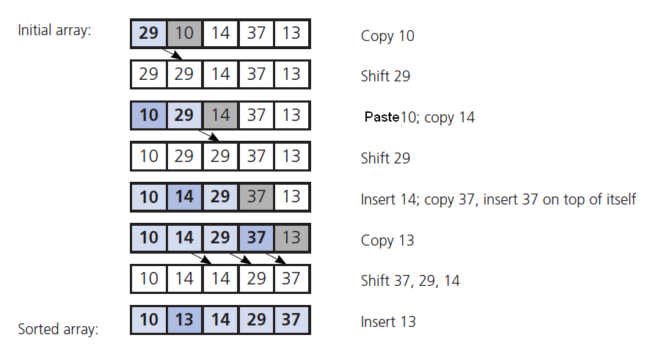
The Insertion Sort (2 of 5)
Figure 11-4 An insertion sort of an array of five integers

Slide 16
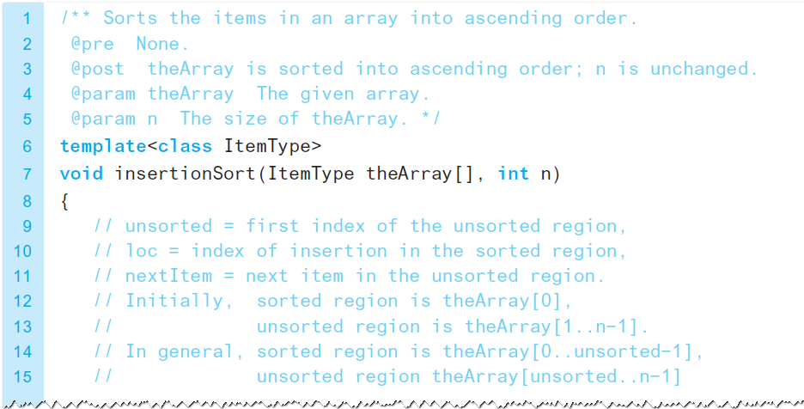
The Insertion Sort (3 of 5)
Listing 11-3 An implementation of the insertion sort

Slide 17
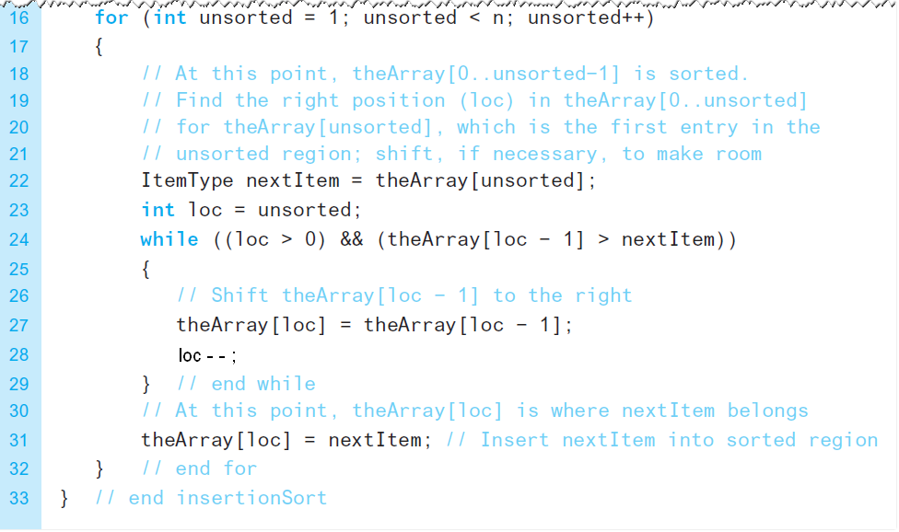
The Insertion Sort (4 of 5)
Listing 11-3 [Continued]

Slide 18
The Insertion Sort (5 of 5)
Analysis
Worst case
Best case (array already in order) is
Appropriate for small (n < 25) arrays
Unsuitable for large arrays
Unless already sorted

Slide 19
Faster Sorting Algorithms
The Merge Sort
The Quick Sort
The Radix Sort

Slide 20
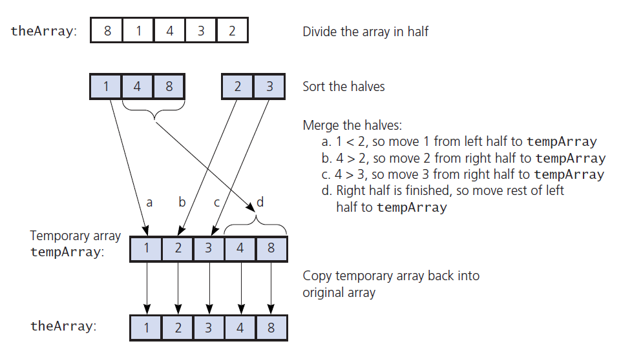
Merge Sort (1 of 9)
Figure 11-5 A merge sort with an auxiliary temporary array

Slide 21
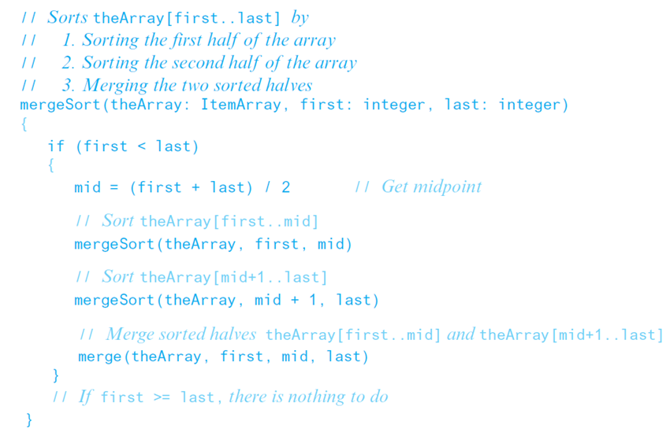
Merge Sort (2 of 9)
Pseudocode for the merge sort

Slide 22
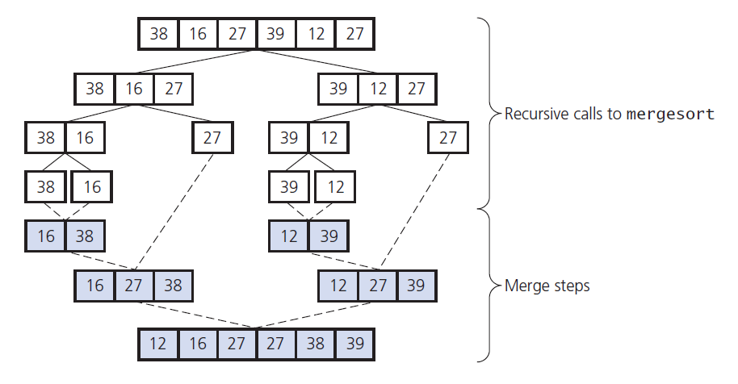
Merge Sort (3 of 9)
Figure 11-6 A merge sort of an array of six integers

Slide 23
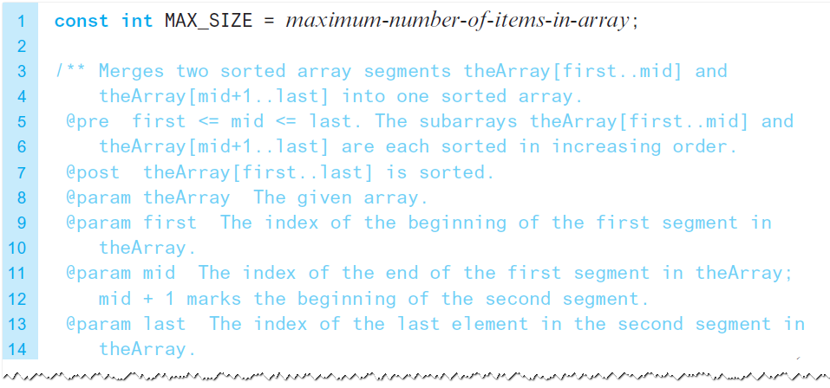
Merge Sort (4 of 9)
Listing 11-4 An implementation of merge and mergeSort

Slide 24
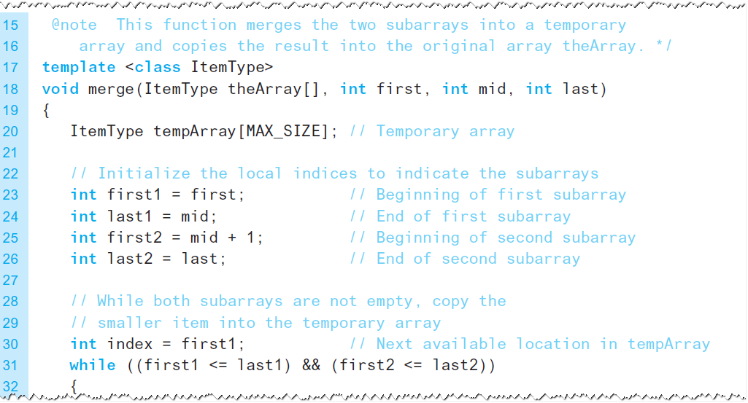
Merge Sort (5 of 9)
Listing 11-4 [Continued]

Slide 25
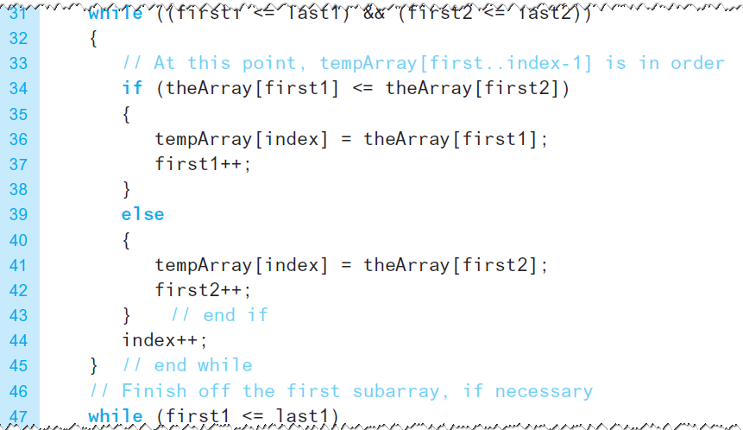
Merge Sort (6 of 9)
Listing 11-4 [Continued]

Slide 26
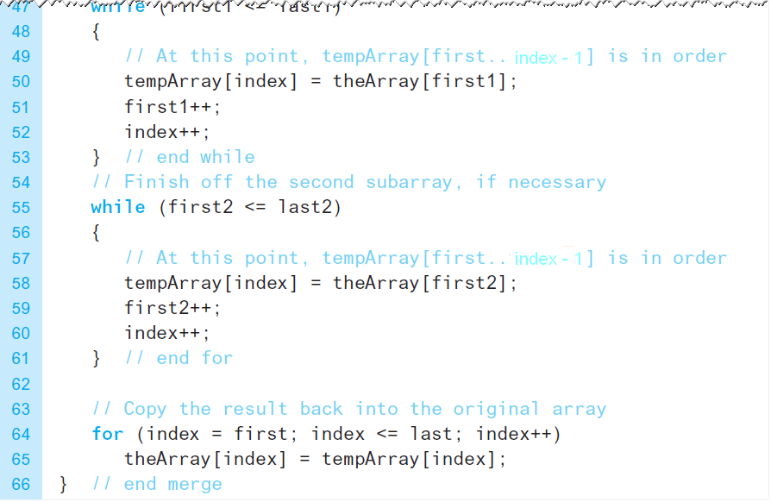
Merge Sort (7 of 9)
Listing 11-4 [Continued]

Slide 27
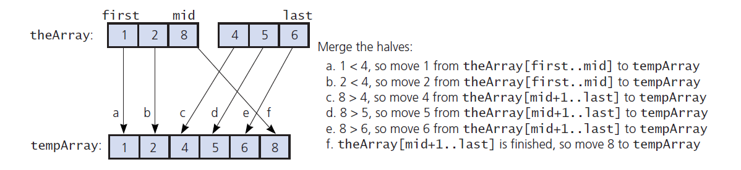
Merge Sort (8 of 9)
Figure 11-7 A worst-case instance of the merge step in a merge sort

Slide 28
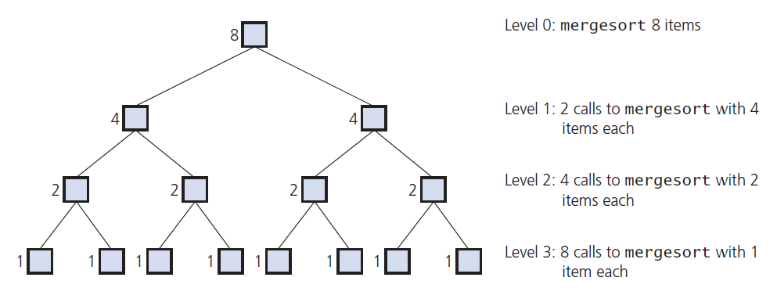
Merge Sort (9 of 9)
Figure 11-8 of recursive calls to mergeSort, given an array of Levelseight items

Slide 29
The Quick Sort (1 of 15)
Another divide-and-conquer algorithm
Partitions an array into items that are
Less than or equal to the pivot and
Those that are greater than or equal to the pivot
Partitioning places pivot in its correct position within the array
Place chosen pivot in theArray[last] before partitioning

Slide 30
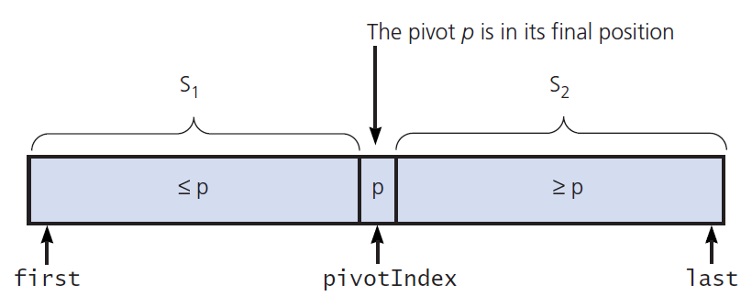
The Quick Sort (2 of 15)
Figure 11-9 A partition about a pivot

Slide 31
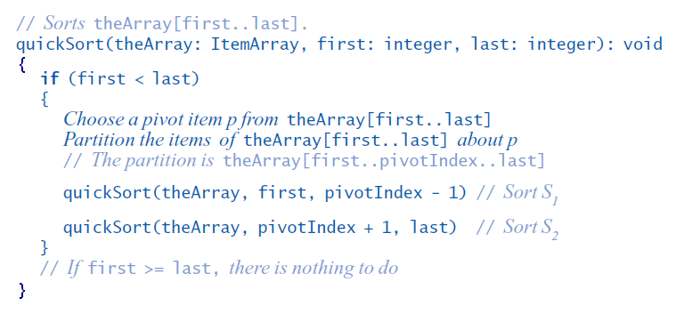
The Quick Sort (3 of 15)
First draft of pseudocode for the quick sort algorithm

Slide 32
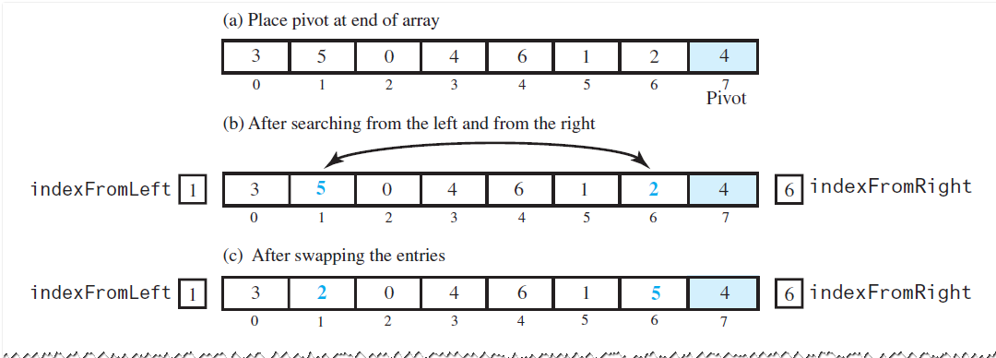
The Quick Sort (4 of 15)
Figure 11-10 A partitioning of an array during a quick sort

Slide 33
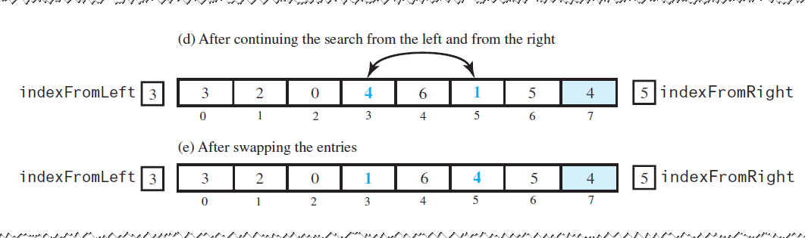
The Quick Sort (5 of 15)
Figure 11-10 [Continued]

Slide 34
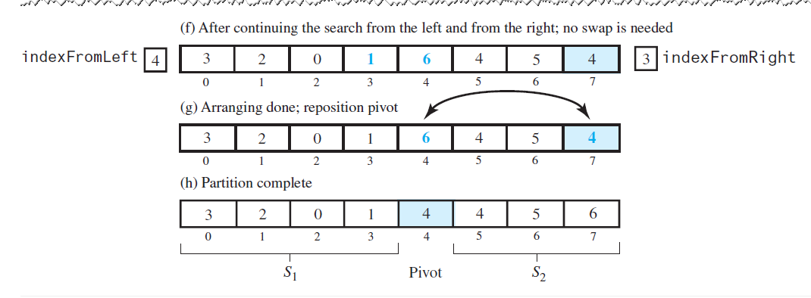
The Quick Sort (6 of 15)
Figure 11-10 [Continued]

Slide 35
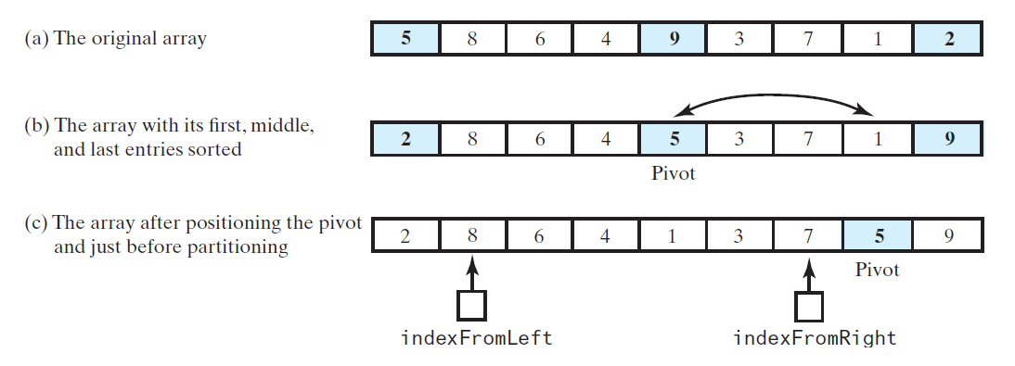
The Quick Sort (7 of 15)
Figure 11-11 Median-of-three pivot selection

Slide 36
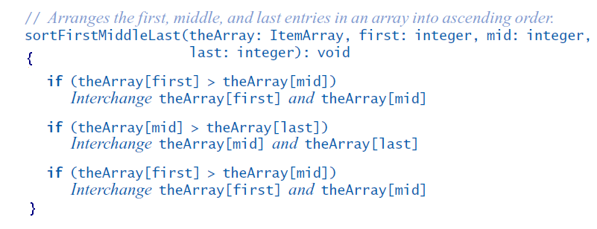
The Quick Sort (8 of 15)
Adjusting the partition algorithm.

Slide 37
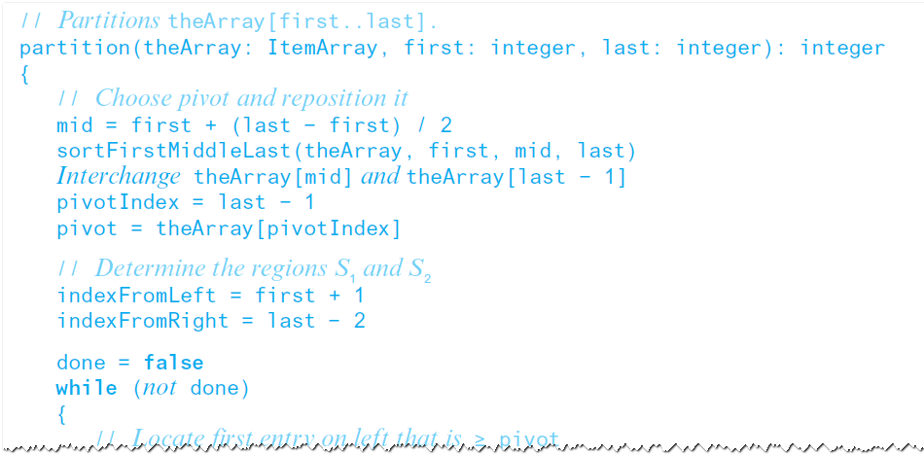
The Quick Sort (9 of 15)
Pseudocode describes the partitioning algorithm for an array of at least four entries

Slide 38
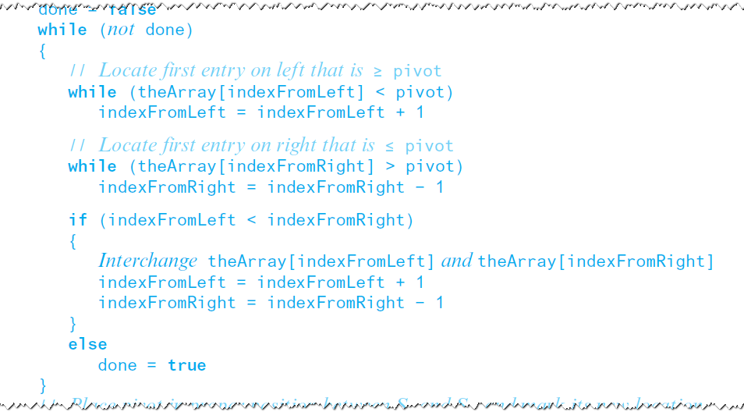
The Quick Sort (10 of 15)
Pseudocode describes the partitioning algorithm for an array of at least four entries

Slide 39
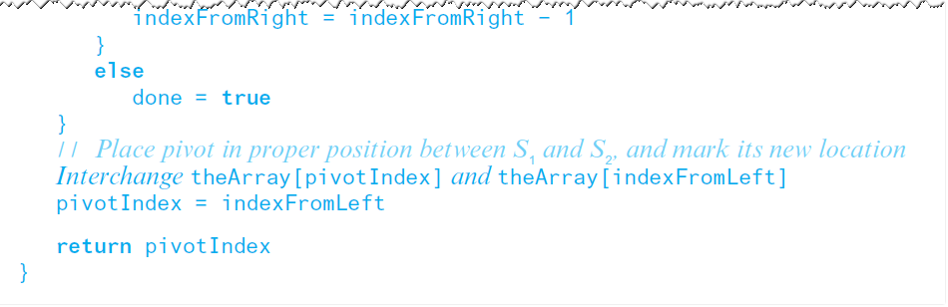
The Quick Sort (11 of 15)
Pseudocode describes the partitioning algorithm for an array of at least four entries

Slide 40
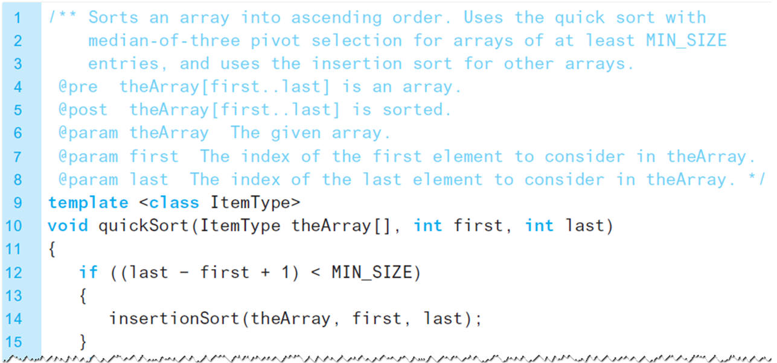
The Quick Sort (12 of 15)
Listing 11-5 A function that performs a quick sort

Slide 41
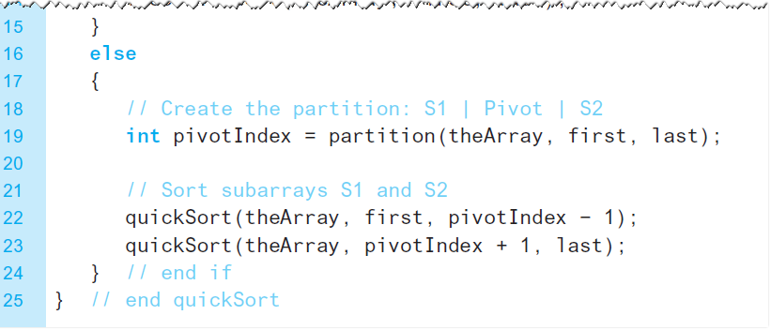
The Quick Sort (13 of 15)
Listing 11-5 [Continued]

Slide 42
The Quick Sort (14 of 15)
Analysis
Partitioning is an
task
There are either
levels of recursive
calls to quickSort.
We conclude
Worst case
Average case

Slide 43
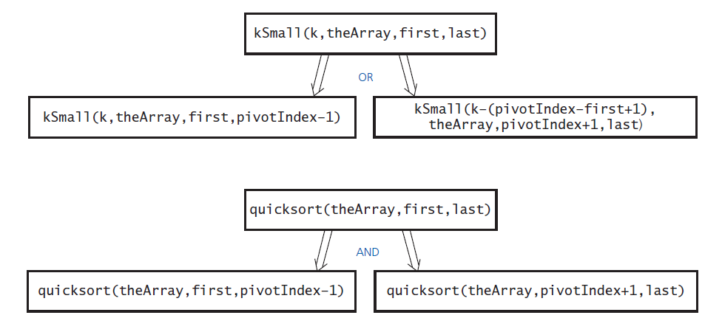
The Quick Sort (15 of 15)
Figure 11-12 kSmall versus quickSort

Slide 44
The Radix Sort (1 of 4)
Different from other sorts
Does not compare entries in an array
Begins by organizing data (say strings) according to least significant letters
Then combine the groups
Next form groups using next least signficant letter

Slide 45
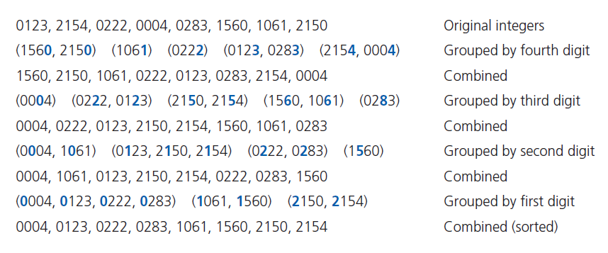
The Radix Sort (2 of 4)
Figure 11-13 A radix sort of eight integers

Slide 46
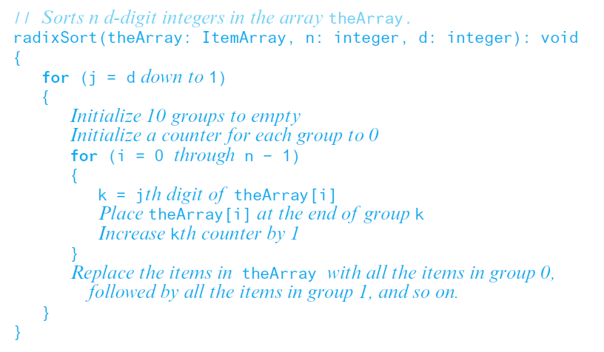
The Radix Sort (3 of 4)
Pseudocode for algorithm for a radix sort of n decimal integers of d digits each:

Slide 47
The Radix Sort (4 of 4)
Analysis
Requires n moves each time it forms groups
n moves to combine again into one group
Performs these 2 × n moves d times
Thus requires 2 × n × d moves
Radix sort is of order
More appropriate for chain of linked lists than for an array

Slide 48
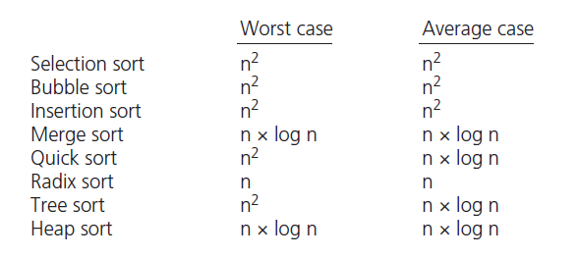
A Comparison of Sorting Algorithms
Figure 11-14 Approximate growth rates of time required for eight sorting algorithms

Slide 49

Copyright

